Slide 1

Main Project Review-1
Batch No: 3 CST
Blockchain for Enhancing Trust and Privacy in Electronic Know Your Customer
S. No | Roll Number | Student Name
1 | 21A81A0612 | G SRI PRABHU KIRAN
2 | 21A81A0623 | K SAI PRASANTH
3 | 21A81A0654 | P SRINIVASA RAO
4 | 21A81A0634 | L T S CHANDRAHAS
5 | 22A85A0606 | SK SAJID
Project Guide:
Mrs. A NAGA JYOTHI (M.Tech) Assistant professor

Slide 2
MAIN PROJECT REVIEW I-CONTENTS
Abstract
Literature Survey
Objectives
Scope of the Project
System Architecture
Methodology

Slide 3
Abstract
This paper presents e-KYC Trust Block, a blockchain-based electronic Know Your Customer (e-KYC) system that enhances trust, security, and privacy in identity verification. Traditional e-KYC systems rely on cloud storage and conventional encryption, leading to key management complexities and security vulnerabilities. To address these challenges, e-KYC Trust Block integrates Ciphertext Policy Attribute-Based Encryption (CP-ABE) for fine-grained access control and Interplanetary File System (IPFS) for secure document storage. Additionally, it employs smart contracts to enforce client consent and ensure auditability. By combining symmetric and public-key encryption, the system minimizes communication overhead while maintaining data confidentiality. Experimental results validate its efficiency, scalability, and security, making it a robust solution for privacy-preserving e-KYC processes.

Slide 4
Literature Survey
S.No | Authors | Research paper | Published Year | Techniques used | Conclusion
1. | Sharma, P. and others | Enhancing Privacy in e-KYC Systems Using Zero-Knowledge Proofs | 2023 | Zero-Knowledge Proofs, e-KYC | Demonstrated how zero-knowledge proofs can enhance e-Kyc System
2 | Patel, D. and others | A Blockchain-Based Approach for Secure and Efficient Verification | 2022 | Blockchain, Smart Contracts, Data Encryption | Proposed a blockchain-based system for secure and efficient identity verification.

Slide 5
Literature Survey
S.No | Authors | Research paper | Publication | Techniques used | Conclusion
3 | Kumar, A. and other | Blockchain Technology for Secure and Transparent e-Governance Systems | 2021 | Blockchain, e-Governance, Transparency, Security | Explored blockchain's potential in enhancing transparency and security in e-governance.
4 | Zhang, R. and other | Privacy-Preserving e-KYC System | 2020 | e-KYC, Zero-Knowledge Proofs, Cryptography | Developed a privacy-preserving e-KYC system using secure identity verification.

Slide 6
Literature Survey
S.No | Authors | Research paper | Publication | Techniques used | Conclusion
5 | Wang and other | Blockchain-Based Fair Payment Protocol for E-Commerce Transactions | 2018 | Blockchain, Smart Contracts, Fair Exchange Protocols | Proposed a blockchain-based protocol for secure and fair e-commerce transactions.
6 | Li, X. and other | A Survey on the Security of Blockchain Systems | 2017 | Blockchain Security, Cryptography, Consensus Mechanisms | Highlighted security challenges and solutions in blockchain systems.

Slide 7
Objective
Enhance Trust: Ensure transparency and immutability of e-KYC data using blockchain.
Preserve Privacy: Protect sensitive user data through encryption and decentralized storage (e.g., IPFS).
Streamline Verification: Enable seamless and secure verification of user identities by authorized entities.
Eliminate Centralized Risks: Reduce dependency on centralized systems, minimizing risks of data breaches and unauthorized access.
Facilitate Compliance: Ensure compliance with regulatory requirements by providing a tamper-proof audit trail of all transactions.

Slide 8
Scope of the Project
Clients (Owners):
Upload e-KYC details securely to the system.
View all uploaded e-KYC details for transparency.
Cloud Server (IPFS):
Store e-KYC data in a decentralized manner using IPFS.
Provide access to permitted e-KYC details, transaction results, and permission status.
Authority:
Authorize clients and smart contract users.
Monitor and manage access permissions for e-KYC data.
Blockchain Server:
Create and maintain a blockchain ledger for storing e-KYC details.
Ensure immutability and transparency of all transactions.
Smart Contracts:
Automate the verification and authorization processes.
Enforce rules and permissions for accessing e-KYC data.

Slide 9
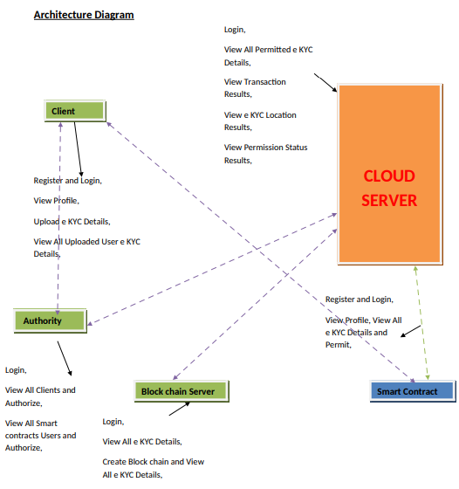
System Architecture

Slide 10
Methodology
Requirement Analysis:
Identify the needs of clients, authorities, and other stakeholders.
Define functional and non-functional requirements for the system.
System Design:
Design the architecture of the system, including modules for clients, cloud servers, authorities, and blockchain servers.
Define the flow of data and interactions between modules.

Slide 11
Methodology
Technology Stack:
Frontend: HTML, JSP (Java Server Pages) for user interfaces.
Backend: Java Servlets for server-side logic.
Database: MySQL for storing non-sensitive metadata.
Implementation:
Develop the client module for uploading and viewing e-KYC details.
Implement the cloud server module for managing IPFS storage and permissions.
Create the authority module for authorizing clients and users.
Build the blockchain server module for creating and managing the blockchain ledger.
Write smart contracts to automate verification and authorization processes.

Slide 12
Methodology
Testing:
Perform unit testing, integration testing, and system testing to ensure functionality.
Conduct security testing to validate data privacy and integrity.
Deployment:
Deploy the system on a secure server.
Provide user training and documentation for stakeholders.

Slide 13
Conclusion
This project demonstrates the potential of blockchain technology to revolutionize identity verification systems, making them more secure, efficient, and user-centric. Future enhancements could include integration AI for fraud detection and expanding the system to support cross-border e-KYC verification.

Slide 14
Thank you

